Slide 1

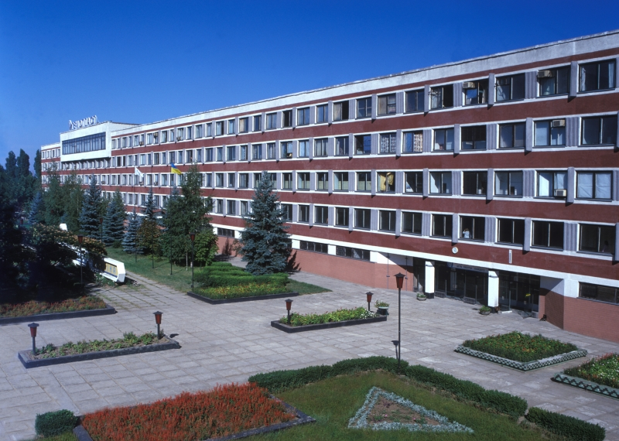
Limited Liability Company “Production and Trade Company “HEMOPLAST”
(LLC “Hemoplast”)

Slide 2
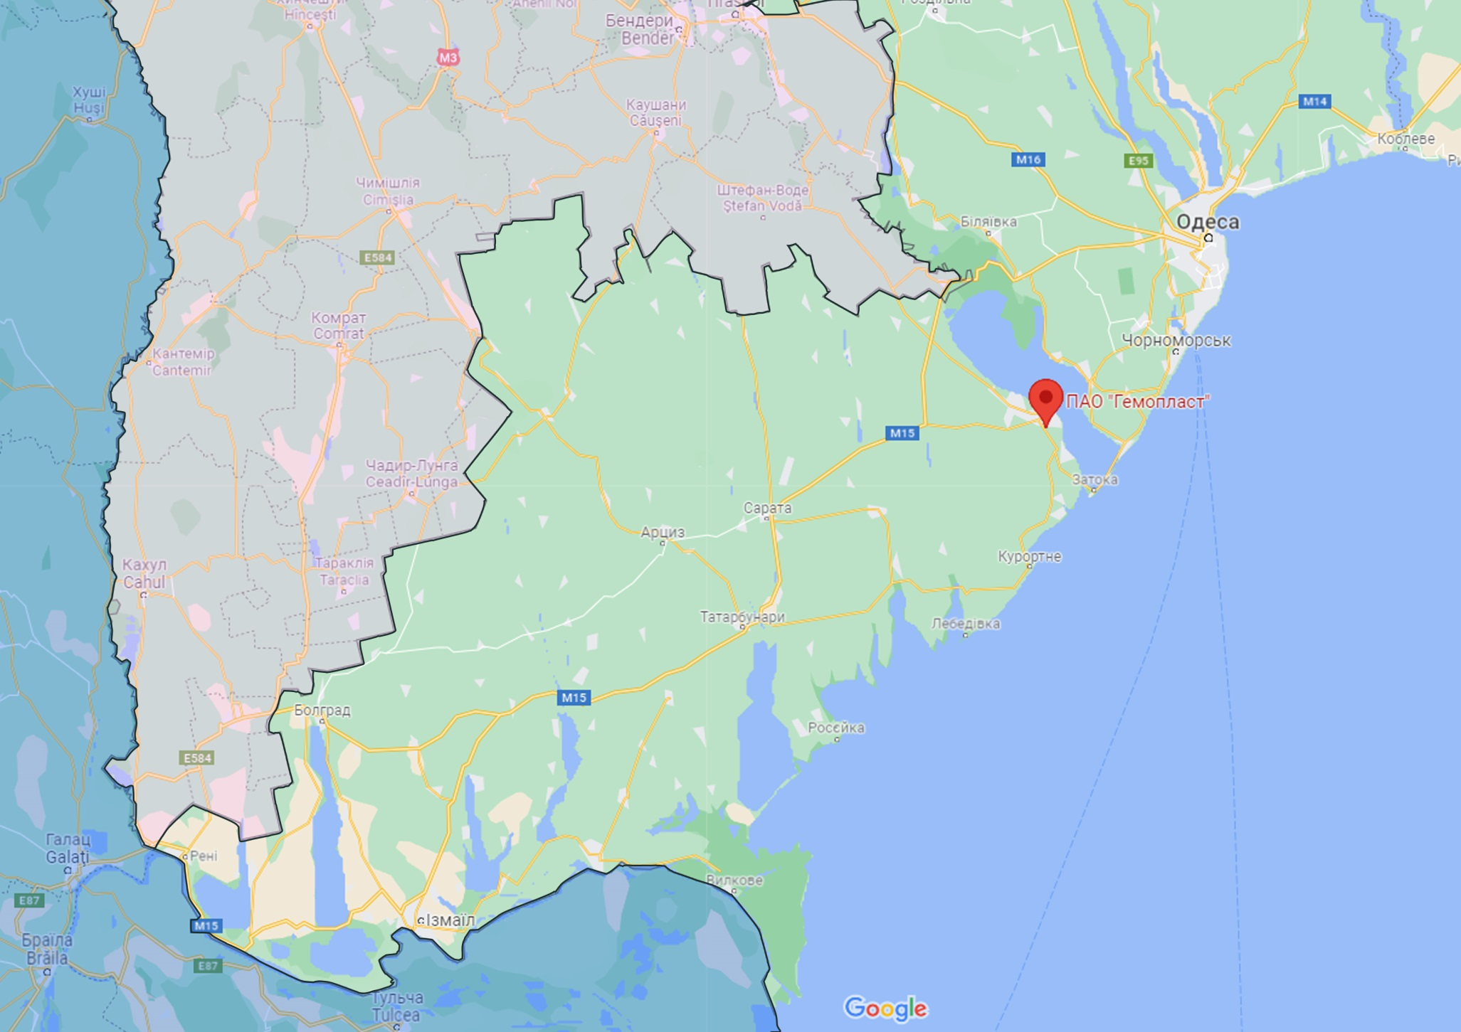





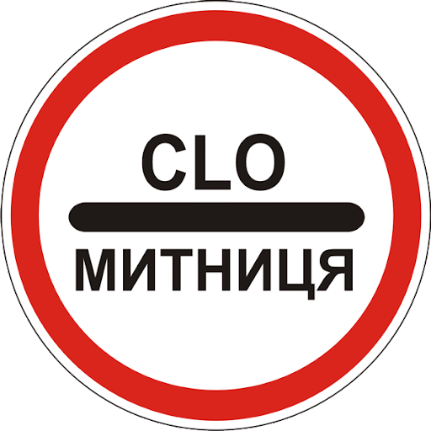



LLC “Hemoplast” is located in southern part of Ukraine,
near international routes to Moldova and Romania.
Kyiv - 543 km
Port “Odesa” - 80 km
Port “Chornomorsk” - 60 km
Port “Yuzhny” - 126 km
Checkpoint, border with Moldova - 40 km
Chisinau - 165 km
LLC “Hemoplast”
Port “Izmail” - 180 km
Checkpoint, border with Romania, Reni - 245 km
Bucharest - 500 km
Sofia - 880 km

Slide 3
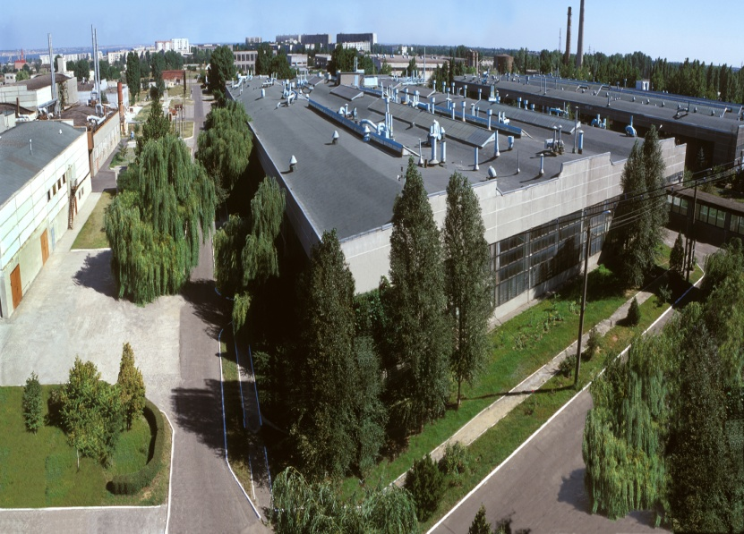
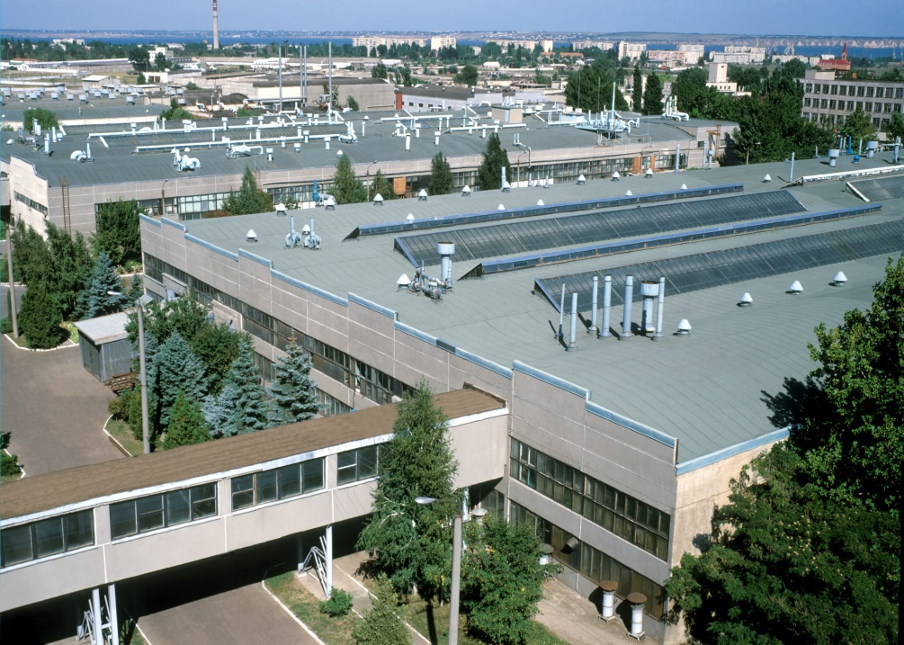
About company
LLC “Hemoplast” is largest manufacturer in Ukraine of sterile medical products from polymeric materials: syringes in assortment, transfusion/infusion sets, catheters, containers and other medical products. Besides, we manufacture wide range of consumer goods from polymer materials.
Since 2005, company began to provide injection molding services for other industrial enterprises of Ukraine, supplying them with components and technical goods.
3

Slide 4
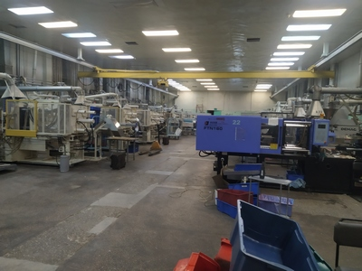
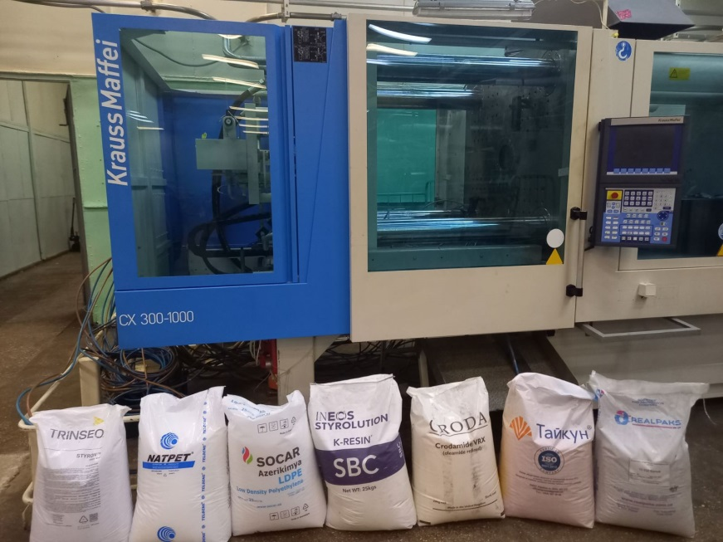
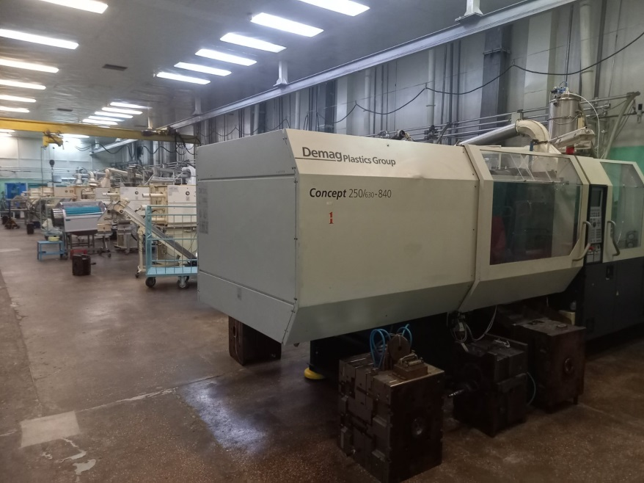
Production capacity
Two injection molding facilities for production of plastic products operate at enterprise, area of each is more than 1000 m². Equipment stock comprises more than 50 injection molding machines with clamping force from 50 to 850 tons (50-8500 kN), which allow to produce products with weight from 1 g to 10 kg. Equipment stock includes:
10 injection molding machines of the same type with 100 t clamping force, shot volume 240 g, maximum mould dimensions 365 x 360 mm;
17 injection molding machines with clamping force 150 tons, shot volume 350 g, maximum mould dimensions 460 x 460 mm;
Injection molding machines with clamping force 300, 480, 650, 850 tons, shot volume 600 g, 1800 g, 2700 g, 3900 g respectively. Maximum possible mould overall dimensions are 1050 x 1050 mm..
4

Slide 5
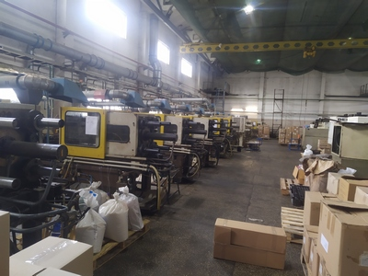
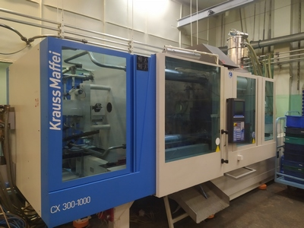
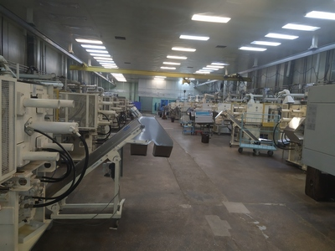
Production capacity
There is possibility to manufacture nonstandard products with collateral parts on vertical machines (metal fittings are filled with plastic). Available equipment allows processing of any type of plastics, including those that require preliminary preparation.
Separate group of equipment includes extruders which allow to produce products of any profile (tubes, hoses of any diameter, polyethylene films etc), blow molding machines, high-frequency welding machines, cutting, printing machines etc.
Enterprise possesses material, technical and intellectual capabilities to manufacture molds, tooling, peripherals, metal processing machines and nonstandard equipment, which allows to manufacture almost any product according to customer’s order, using customer's tooling or our own equipment.
5

Slide 6
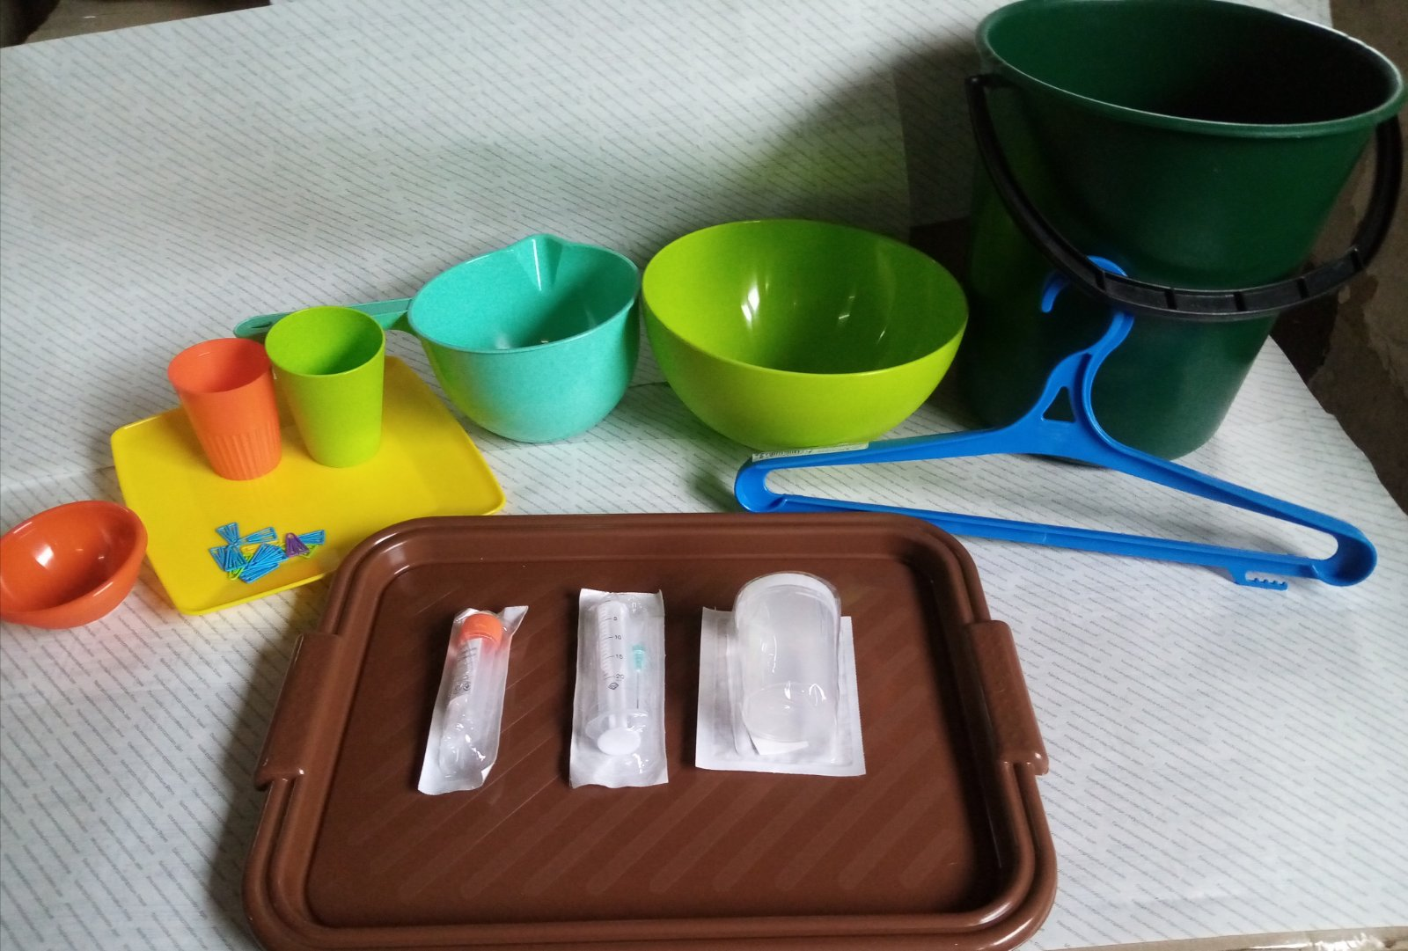
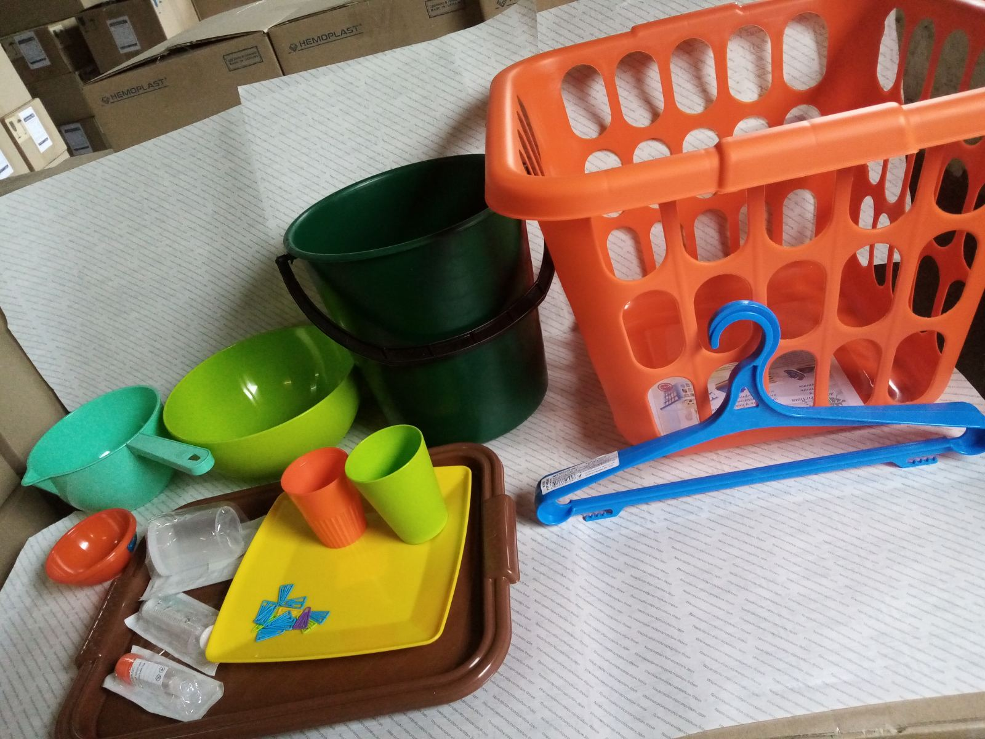
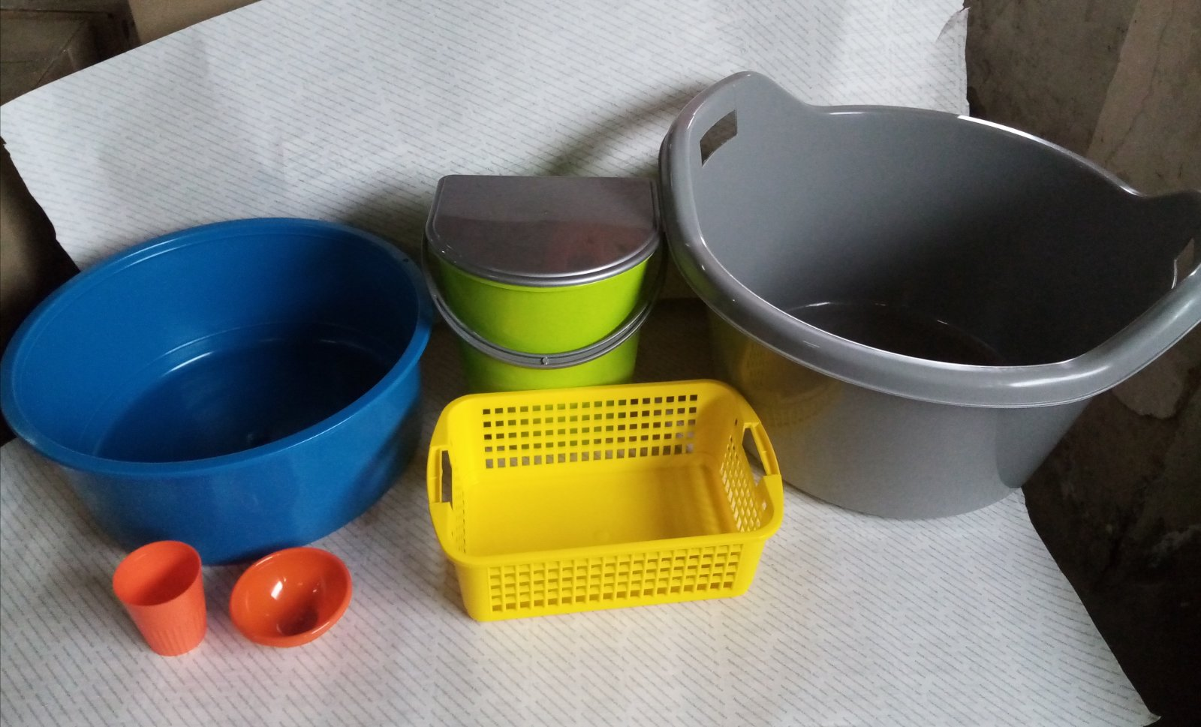
Technical possibilities
Company has long-term successful experience in processing of the following types of raw materials: LDPE (high-pressure polyethylene), HDPE (low-pressure polyethylene), PP (polypropylene), PS (polystyrene), PC (polycarbonate), TPE (thermoelastoplast), ABS, PVC (polyvinylchloride).
Skilled professional team may operate continuously 24/7 with well-functioning quality control system.
6

Slide 7
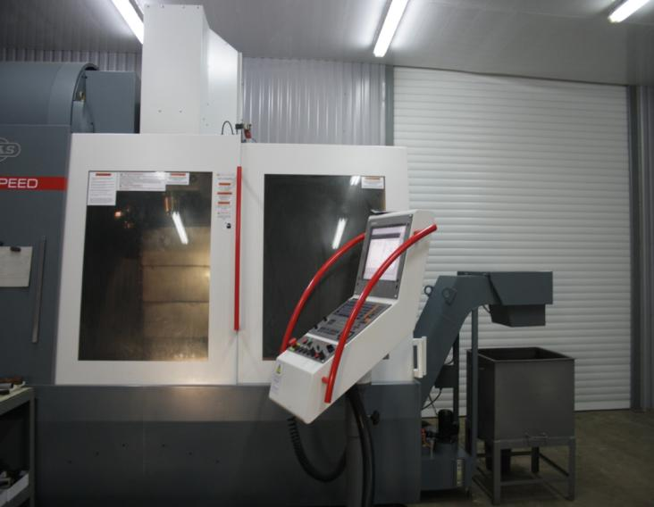
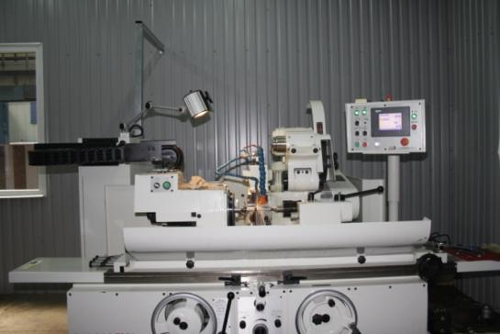
Mechanical processing of materials
LLC “Hemoplast” has its own production base and possibility to carry out turning, milling, electrical erosion, grinding works and heat treatment of stainless or carbon steels, non-ferrous metals and other materials according to customer’s drawings on computer controlled machines (CNC).
Milling works on CNC machines: copying, engraving works, holes drilling by coordinates with thread cutting, hole boring with accuracy of 0,01 mm, manufacture of parts with complex geometry.
7

Slide 8
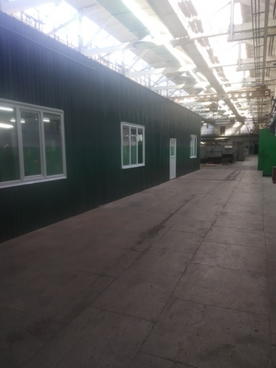
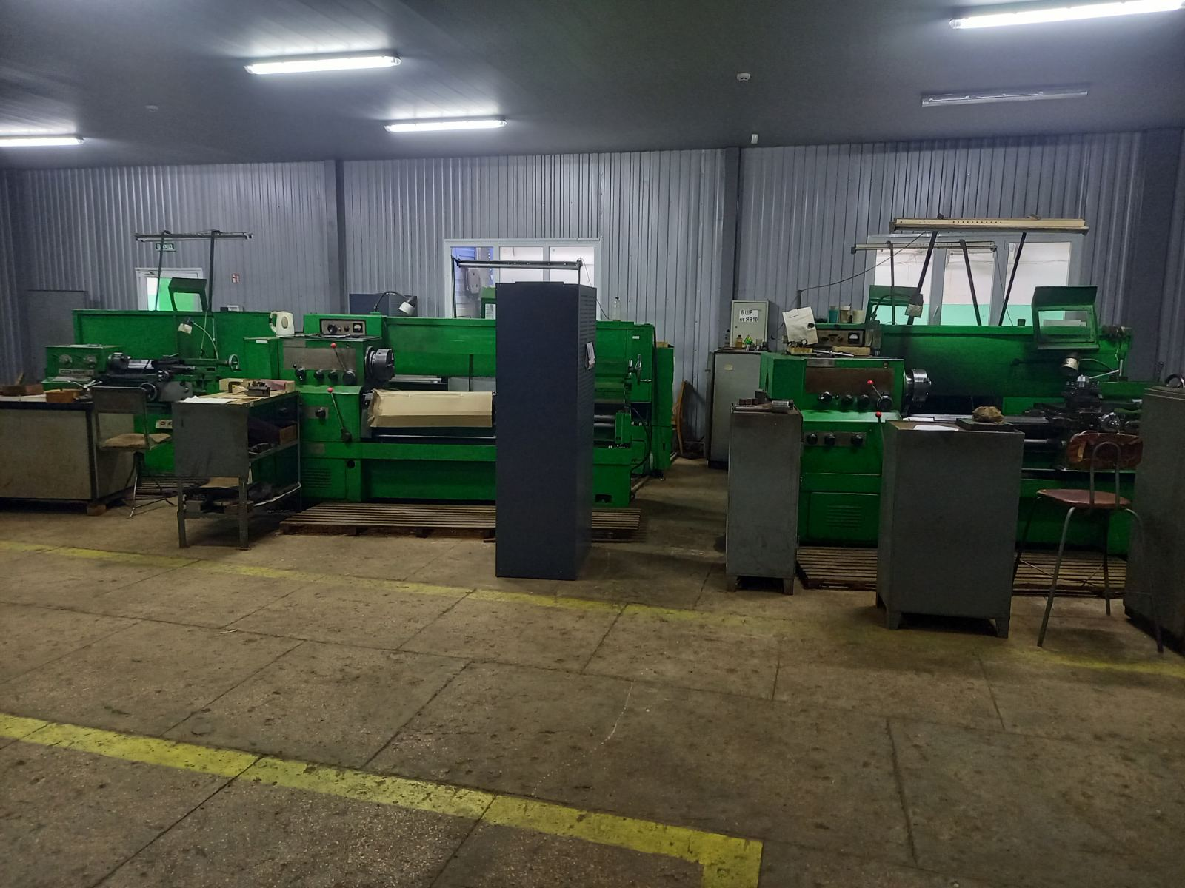
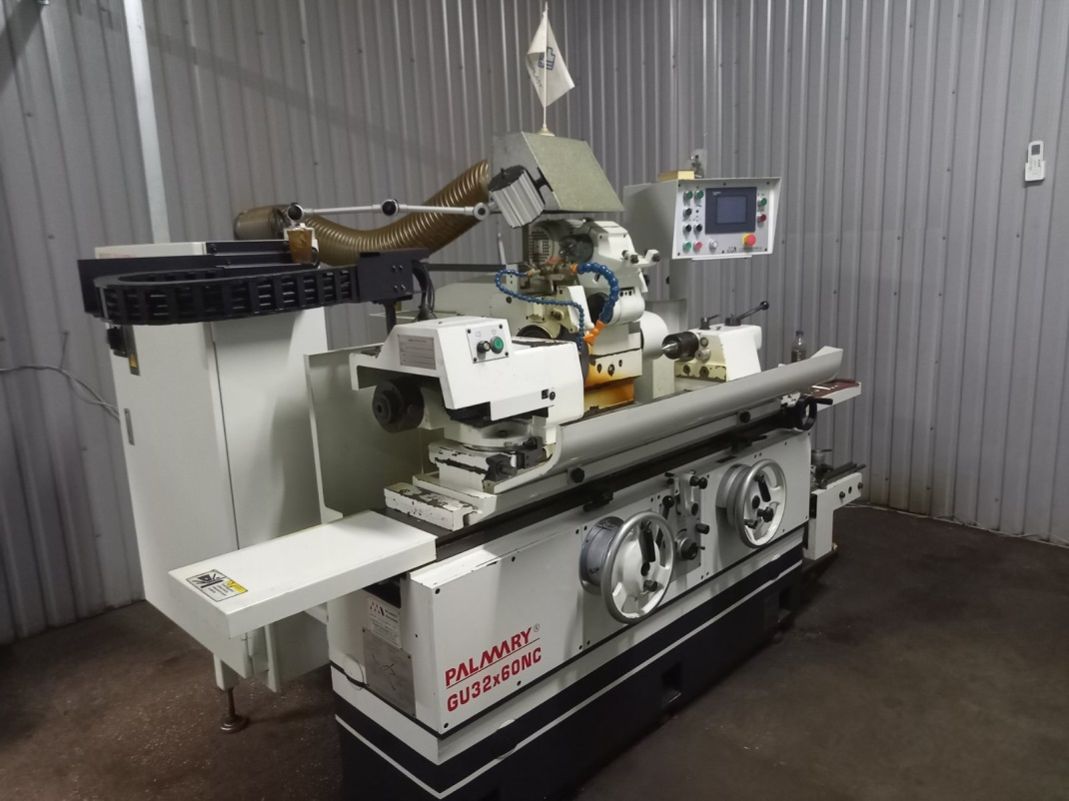
Mechanical processing of materials
Turning works on CNC machines: turning of cylindrical, conical, shaped surfaces; boring of cylindrical and conical holes; processing of end surfaces; cutting of external, internal and conical threads; production of parts of any complexity with accuracy up to 10 microns. Cylindrical grinding machines with CNC: production of precise products and parts with small deviations of shape and size, small parameters of surface roughness.
8

Slide 9
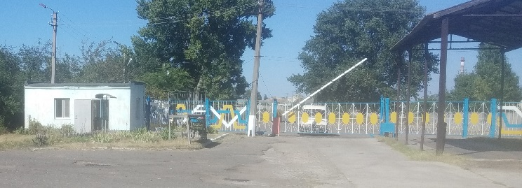
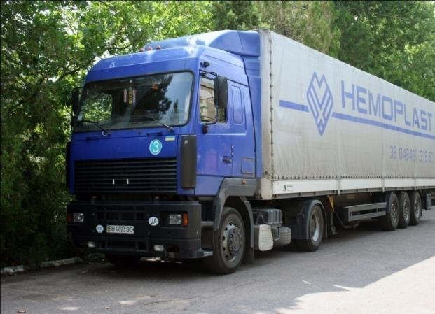
Transport
Company has its own fleet of vehicles and warehouses in Bilhorod-Dnistrovskyi and suburbs of Kyiv, well-functioning logistics system that allows promptly deliver products throughout Ukraine and abroad.
9

Slide 10
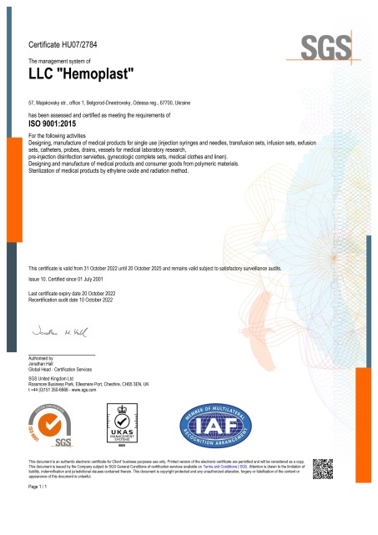
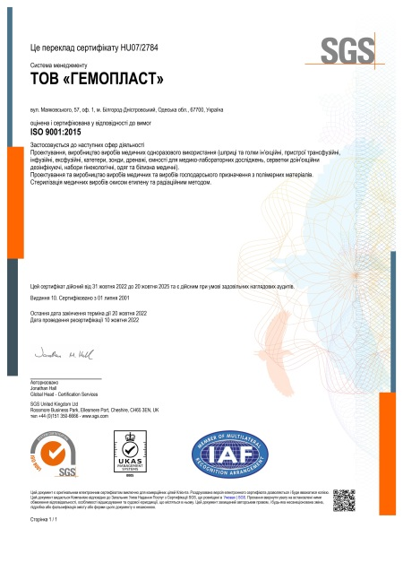
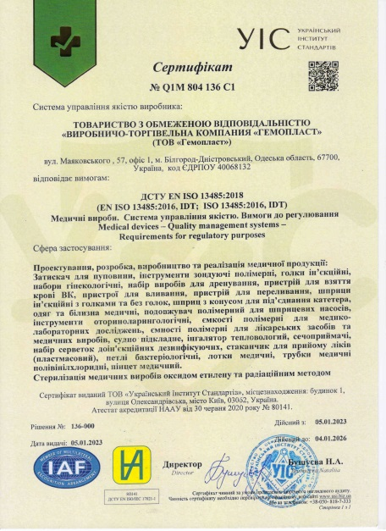
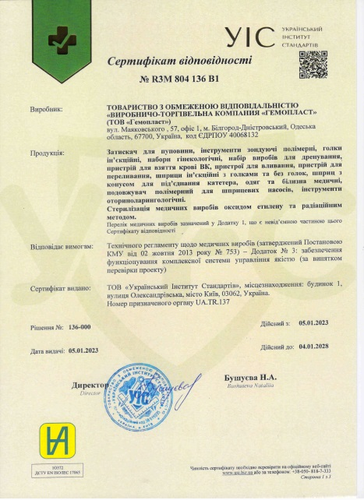
Quality system
LLC “Hemoplast” established Quality Management System, effectiveness of which is confirmed by international certificate ISO 9001 and national certificates DSTU EN ISO 13485.
Medical products manufactured by LLC “Hemoplast” are certified for compliance with requirements of Technical Regulations on Medical Devices.
Testing center of LLC “Hemoplast” is accredited by National Accreditation Agency of Ukraine. Laboratories are equipped with modern testing equipment which is necessary for conducting of toxicological, sanitary-chemical, microbiological and mechanical tests of medical devices. Testing is conducted by highly qualified personnel.
Quality control system existing at enterprise provides incoming quality control of each batch of raw materials, materials, components and control of each batch of manufactured products, which ensures stability and high level of products quality, which means their competitiveness. Visit our web-site: www.hemoplast.ua
10

